Slide 1
Introduction to Parallel Computing
Dr. Nausheen Shoaib

Slide 2
Marks Distribution
Assignment, Project, Quiz : 20%
Mid Terms : 30%
Final: 50%
Google Classroom: priwxlk
Book:
1. Introduction to Parallel Computing, Second Edition
by Ananth Grama, Anshul Gupta, George Karypis, Vipin Kumar
2. Programming Parallel Processors, second Edition
by by David Kirk
3. Big Data Systems: A 360 degree Approach
by Jawwad Shamsi

Slide 3
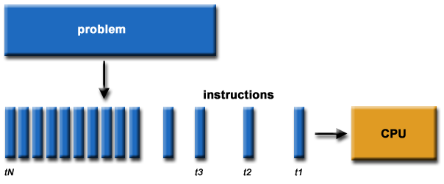
What is Parallel Computing? (1)
Traditionally, software has been written for serial computation:
To be run on a single computer having a single Central Processing Unit (CPU);
A problem is broken into a discrete series of instructions.
Instructions are executed one after another.
Only one instruction may execute at any moment in time.

Slide 4
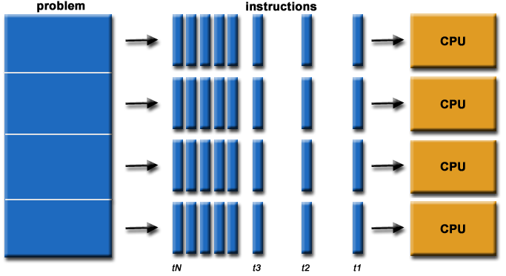
What is Parallel Computing? (2)
In the simplest sense, parallel computing is the simultaneous use of multiple compute resources to solve a computational problem.
To be run using multiple CPUs
A problem is broken into discrete parts that can be solved concurrently
Each part is further broken down to a series of instructions
Instructions from each part execute simultaneously on different CPUs

Slide 5
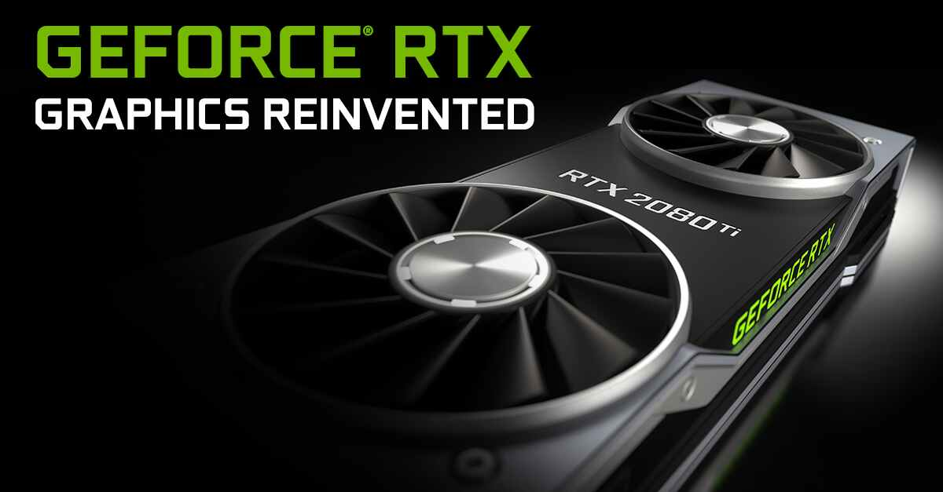

Parallel Computing: Resources
The compute resources can include:
A single computer with multiple processors;
A single computer with (multiple) processor(s) and some specialized computer resources (GPU, FPGA …)
An arbitrary number of computers connected by a network;
A combination of both.

Slide 6
Parallel Computing: The computational problem
The computational problem usually demonstrates characteristics such as the ability to be:
Broken apart into discrete pieces of work that can be solved simultaneously;
Execute multiple program instructions at any moment in time;
Solved in less time with multiple compute resources than with a single compute resource.

Slide 7
Parallel Computing: what for? (3)
Example applications include:
parallel databases, data mining
web search engines, web based business services
computer-aided diagnosis in medicine
advanced graphics and virtual reality, particularly in the entertainment industry
networked video and multi-media technologies
Ultimately, parallel computing is an attempt to maximize the infinite but seemingly scarce commodity called time.

Slide 8
Why Parallel Computing?
This is a legitime question! Parallel computing is complex on any aspect!
The primary reasons for using parallel computing:
Save time - wall clock time
Solve larger problems
Provide concurrency (do multiple things at the same time)

Slide 9
Limitations of Serial Computing
Limits to serial computing - both physical and practical reasons pose significant constraints to simply building ever faster serial computers.
Transmission speeds - the speed of a serial computer is directly dependent upon how fast data can move through hardware. Absolute limits are the speed of light (30 cm/nanosecond) and the transmission limit of copper wire (9 cm/nanosecond). Increasing speeds necessitate increasing proximity of processing elements.
Economic limitations - it is increasingly expensive to make a single processor faster. Using a larger number of moderately fast commodity processors to achieve the same (or better) performance is less expensive.

Slide 10
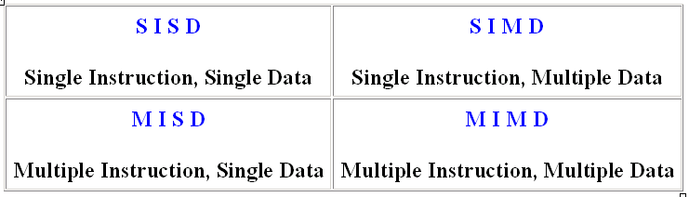
Flynn Taxanomy
The matrix below defines the 4 possible classifications according to Flynn

Slide 11
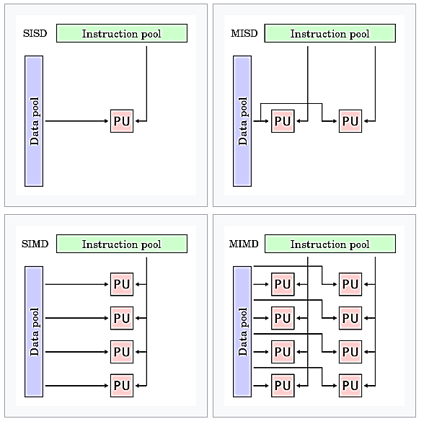
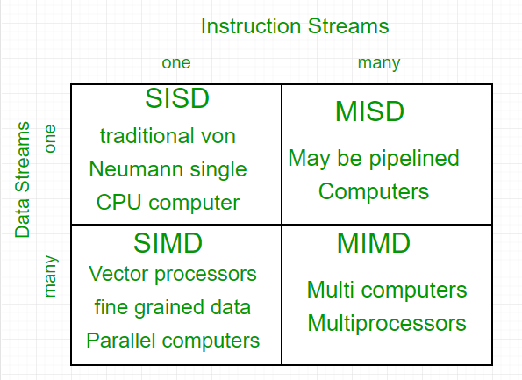
Flynn’s Taxonomy
PU = Processing Unit

Slide 12
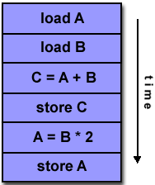
Single Instruction, Single Data (SISD)
A serial (non-parallel) computer
Single instruction: only one instruction stream is being acted on by the CPU during any one clock cycle
Single data: only one data stream is being used as input during any one clock cycle
Deterministic execution
This is the oldest and until recently, the most prevalent form of computer
Examples: most PCs, single CPU workstations and mainframes

Slide 13
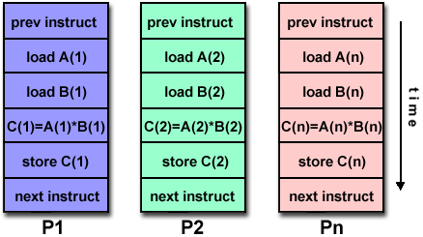
Single Instruction, Multiple Data (SIMD)
A type of parallel computer
Single instruction: All processing units execute the same instruction at any given clock cycle
Multiple data: Each processing unit can operate on a different data element
This type of machine typically has an instruction dispatcher, a very high-bandwidth internal network, and a very large array of very small-capacity instruction units.
Best suited for specialized problems characterized by a high degree of regularity,such as image processing.
Synchronous (lockstep) and deterministic execution
Two varieties: Processor Arrays and Vector Pipelines
Examples:
Processor Arrays: Connection Machine CM-2, Maspar MP-1, MP-2
Vector Pipelines: IBM 9000, Cray C90, Fujitsu VP, NEC SX-2, Hitachi S820

Slide 14
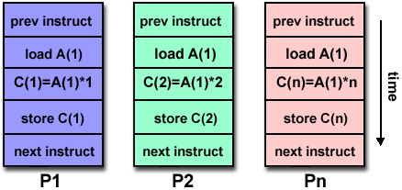
Multiple Instruction, Single Data (MISD)
A single data stream is fed into multiple processing units.
Each processing unit operates on the data independently via independent instruction streams.
Few actual examples of this class of parallel computer have ever existed. One is the experimental Carnegie-Mellon C.mmp computer (1971).
Some conceivable uses might be:
multiple frequency filters operating on a single signal stream
multiple cryptography algorithms attempting to crack a single coded message.

Slide 15
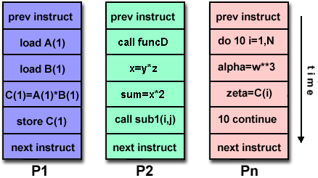
Multiple Instruction, Multiple Data (MIMD)
Currently, the most common type of parallel computer. Most modern computers fall into this category.
Multiple Instruction: every processor may be executing a different instruction stream
Multiple Data: every processor may be working with a different data stream
Execution can be synchronous or asynchronous, deterministic or non-deterministic
Examples: most current supercomputers, networked parallel computer "grids" and multi-processor SMP computers - including some types of PCs.

Slide 16
Some General Parallel Terminology
Task
A logically discrete section of computational work. A task is typically a program or program-like set of instructions that is executed by a processor.
Parallel Task
A task that can be executed by multiple processors safely (yields correct results)
Serial Execution
Execution of a program sequentially, one statement at a time. In the simplest sense, this is what happens on a one processor machine. However, virtually all parallel tasks will have sections of a parallel program that must be executed serially.

Slide 17
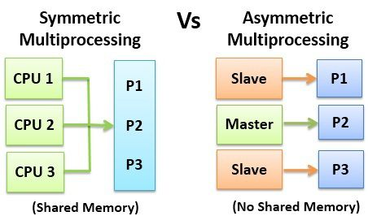
Symmetric vs. Asymmetric Multiprocessing Architecture [1/2]

Slide 18
Some General Parallel Terminology
Parallel Execution
Execution of a program by more than one task, with each task being able to execute the same or different statement at the same moment in time.
Shared Memory
From a strictly hardware point of view, describes a computer architecture where all processors have direct (usually bus based) access to common physical memory. In a programming sense, it describes a model where parallel tasks all have the same "picture" of memory and can directly address and access the same logical memory locations regardless of where the physical memory actually exists.
Distributed Memory
In hardware, refers to network based memory access for physical memory that is not common. As a programming model, tasks can only logically "see" local machine memory and must use communications to access memory on other machines where other tasks are executing.

Slide 19
Some General Parallel Terminology
Communications
Parallel tasks typically need to exchange data. There are several ways this can be accomplished, such as through a shared memory bus or over a network, however the actual event of data exchange is commonly referred to as communications regardless of the method employed.
Synchronization
The coordination of parallel tasks in real time, very often associated with communications. Often implemented by establishing a synchronization point within an application where a task may not proceed further until another task(s) reaches the same or logically equivalent point.
Synchronization usually involves waiting by at least one task, and can therefore cause a parallel application's wall clock execution time to increase.

Slide 20
Some General Parallel Terminology
Granularity
In parallel computing, granularity is a qualitative measure of the ratio of computation to communication.
Coarse: relatively large amounts of computational work are done between communication events
Fine: relatively small amounts of computational work are done between communication events
Observed Speedup
Observed speedup of a code which has been parallelized, defined as:
wall-clock time of serial execution
wall-clock time of parallel execution
One of the simplest and most widely used indicators for a parallel program's performance.

Slide 21
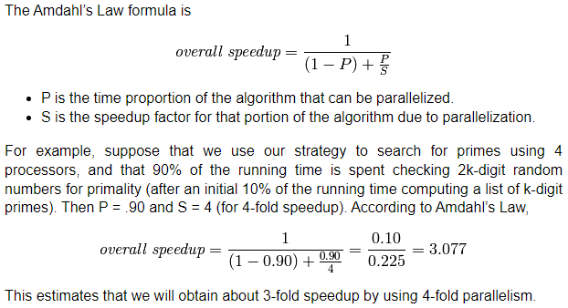
Observed Speedup

Slide 22
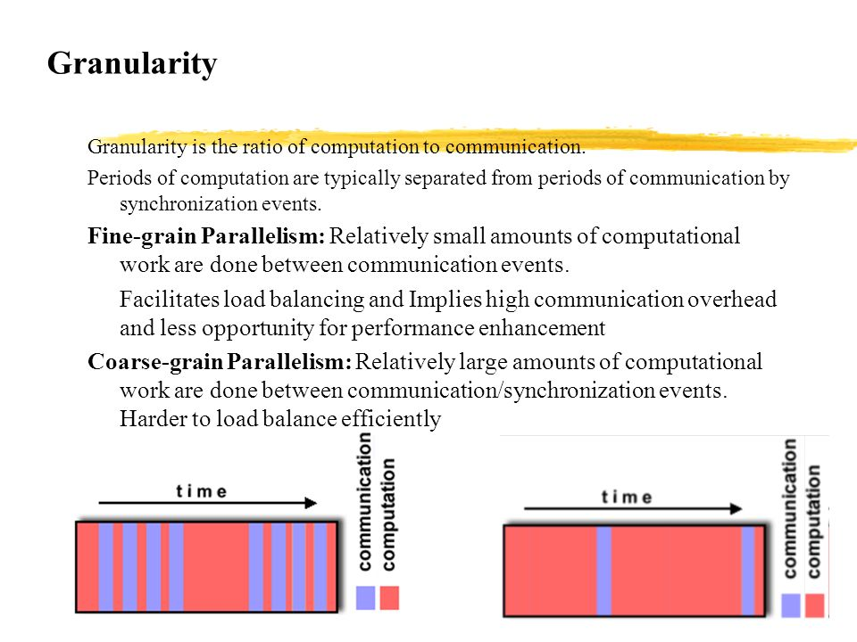

Slide 23
Some General Parallel Terminology
Parallel Overhead
The amount of time required to coordinate parallel tasks, as opposed to doing useful work. Parallel overhead can include factors such as:
Task start-up time
Synchronizations
Data communications
Software overhead imposed by parallel compilers, libraries, tools, operating system, etc.
Task termination time
Massively Parallel
Refers to the hardware that comprises a given parallel system - having many processors. The meaning of many keeps increasing, but currently BG/L pushes this number to 6 digits.

Slide 24
Some General Parallel Terminology
Scalability
Refers to a parallel system's (hardware and/or software) ability to demonstrate a proportionate increase in parallel speedup with the addition of more processors. Factors that contribute to scalability include:
Hardware - particularly memory-cpu bandwidths and network communications
Application algorithm
Parallel overhead related
Characteristics of your specific application and coding

Slide 25
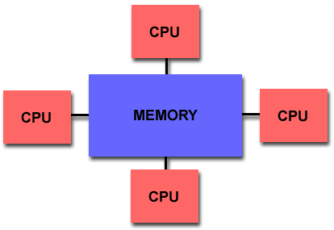
Shared Memory
Shared memory parallel computers vary widely, but generally have in common the ability for all processors to access all memory as global address space.
Multiple processors can operate independently but share the same memory resources.
Changes in a memory location effected by one processor are visible to all other processors.
Shared memory machines can be divided into two main classes based upon memory access times: UMA and NUMA.

Slide 26
Shared Memory : UMA vs. NUMA
Uniform Memory Access (UMA):
Most commonly represented today by Symmetric Multiprocessor (SMP) machines
Identical processors
Equal access and access times to memory
Sometimes called CC-UMA - Cache Coherent UMA. Cache coherent means if one processor updates a location in shared memory, all the other processors know about the update. Cache coherency is accomplished at the hardware level.
Non-Uniform Memory Access (NUMA):
Often made by physically linking two or more SMPs
One SMP can directly access memory of another SMP
Not all processors have equal access time to all memories
Memory access across link is slower
If cache coherency is maintained, then may also be called CC-NUMA - Cache Coherent NUMA

Slide 27
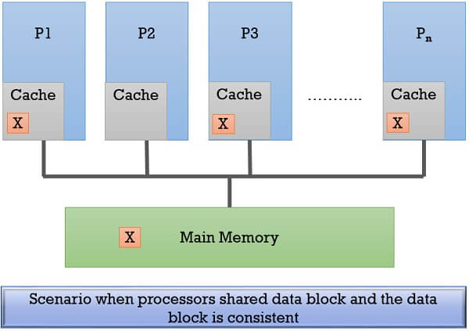
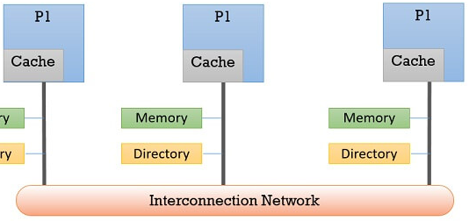
Cache Coherency
Cache coherent means if one processor updates a location in shared memory, all the other processors know about the update.
Cache coherency is accomplished at the hardware level.
An interconnection network on the chip is used to update all caches using some protocol.

Slide 28
Shared Memory: Pro and Con
Advantages
Global address space provides a user-friendly programming perspective to memory
Data sharing between tasks is both fast and uniform due to the proximity of memory to CPUs
Disadvantages:
Primary disadvantage is the lack of scalability between memory and CPUs. Adding more CPUs can geometrically increases traffic on the shared memory-CPU path, and for cache coherent systems, geometrically increase traffic associated with cache/memory management.
Programmer responsibility for synchronization constructs that insure "correct" access of global memory.
Expense: it becomes increasingly difficult and expensive to design and produce shared memory machines with ever increasing numbers of processors.

Slide 29
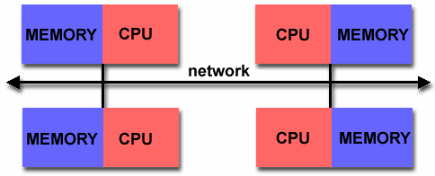
Distributed Memory
Like shared memory systems, distributed memory systems vary widely but share a common characteristic. Distributed memory systems require a communication network to connect inter-processor memory.
Processors have their own local memory. Memory addresses in one processor do not map to another processor, so there is no concept of global address space across all processors.
Because each processor has its own local memory, it operates independently. Changes it makes to its local memory have no effect on the memory of other processors. Hence, the concept of cache coherency does not apply.
When a processor needs access to data in another processor, it is usually the task of the programmer to explicitly define how and when data is communicated. Synchronization between tasks is likewise the programmer's responsibility.
The network "fabric" used for data transfer varies widely, though it can can be as simple as Ethernet.

Slide 30
Distributed Memory: Pro and Con
Advantages
Memory is scalable with number of processors. Increase the number of processors and the size of memory increases proportionately.
Each processor can rapidly access its own memory without interference and without the overhead incurred with trying to maintain cache coherency.
Cost effectiveness: can use commodity, off-the-shelf processors and networking.
Disadvantages
The programmer is responsible for many of the details associated with data communication between processors.
It may be difficult to map existing data structures, based on global memory, to this memory organization.
Non-uniform memory access (NUMA) times

Slide 31
Hybrid Distributed-Shared Memory
Summarizing a few of the key characteristics of shared and distributed memory machines
Comparison of Shared and Distributed Memory Architectures
Architecture | CC-UMA | CC-NUMA | Distributed
Examples | SMPs Sun Vexx DEC/Compaq SGI Challenge IBM POWER3 | Bull NovaScale SGI Origin Sequent HP Exemplar DEC/Compaq IBM POWER4 (MCM) | Cray T3E Maspar IBM SP2 IBM BlueGene
Communications | MPI Threads OpenMP shmem | MPI Threads OpenMP shmem | MPI
Scalability | to 10s of processors | to 100s of processors | to 1000s of processors
Draw Backs | Memory-CPU bandwidth | Memory-CPU bandwidth Non-uniform access times | System administration Programming is hard to develop and maintain
Software Availability | many 1000s ISVs | many 1000s ISVs | 100s ISVs

Slide 32
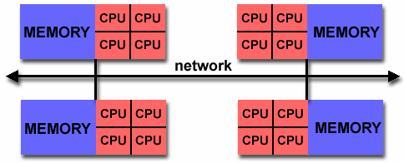
Hybrid Distributed-Shared Memory
The largest and fastest computers in the world today employ both shared and distributed memory architectures.
The shared memory component is usually a cache coherent SMP machine. Processors on a given SMP can address that machine's memory as global.
The distributed memory component is the networking of multiple SMPs. SMPs know only about their own memory - not the memory on another SMP. Therefore, network communications are required to move data from one SMP to another.
Current trends seem to indicate that this type of memory architecture will continue to prevail and increase at the high end of computing for the foreseeable future.
Advantages and Disadvantages: whatever is common to both shared and distributed memory architectures.

Slide 33
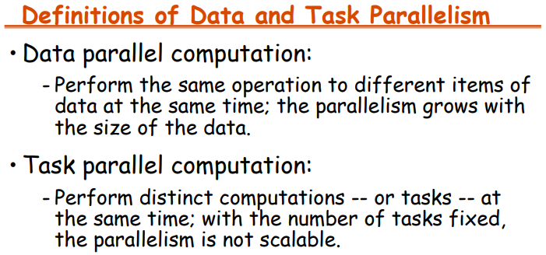
* Implementable on shared memory or distributed Memory

Slide 34
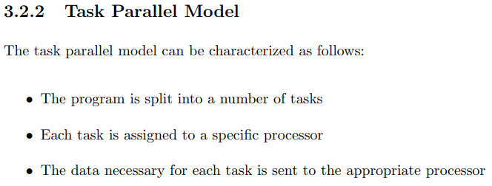

Slide 35
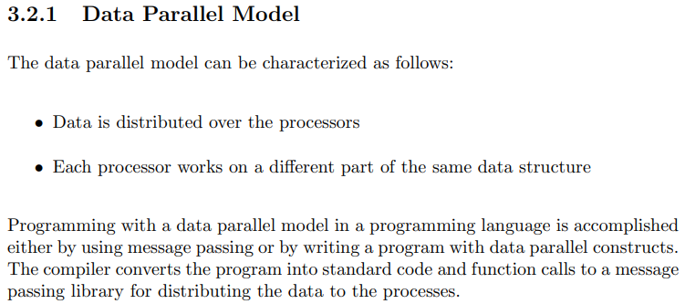

Slide 36
Data Parallel Model
The data parallel model demonstrates the following characteristics:
Most of the parallel work focuses on performing operations on a data set. The data set is typically organized into a common structure, such as an array (1D-2D) or cube (3D).
A set of tasks work collectively on the same data structure, however, each task works on a different partition of the same data structure.
Tasks perform the same operation on their partition of work, for example, "add 4 to every array element".
On shared memory architectures, all tasks may have access to the data structure through global memory.
On distributed memory architectures the data structure is split up and resides as "chunks" in the local memory of each task.

Slide 37
Programming Models
Parallel computing makes it possible to speed up computations a hundred, a thousand, or even tens of thousands of times. The practical difference between obtaining results in hours, rather than weeks or years, is substantial.
There are several parallel programming models in common use:
Shared Memory
Threads
Message Passing
Parallel programming models exist as an abstraction above hardware and memory architectures.

Slide 38
Shared Memory Model
In the shared-memory programming model, tasks share a common address space, which they read and write asynchronously.
An advantage of this model from the programmer's point of view is that the notion of data "ownership" is lacking, so there is no need to specify explicitly the communication of data between tasks.
Program development is simple.
However, various mechanisms (e.g. locks / semaphores) may be used to control access to the shared memory.
An important disadvantage in terms of performance is that it becomes more difficult to understand and manage data locality.

Slide 39
Threads Model Implementations
From a programming perspective, threads implementations commonly comprise:
A library of subroutines that are called from within parallel source code (Pthreads)
C Language only
Very explicit parallelism; requires significant programmer attention to detail.
A set of compiler directives imbedded in either serial or parallel source code (OpenMP is an API)
Supports multi-platform shared-memory multiprocessing programming in C, C++, and Fortran,[3] on many platforms, instruction-set architectures and operating systems, including Solaris, AIX, HP-UX, Linux, macOS, and Windows.
It consists of a set of compiler directives, library routines, and environment variables that influence run-time behavior.
The programmer is responsible for determining all parallelism in both cases.

Slide 40
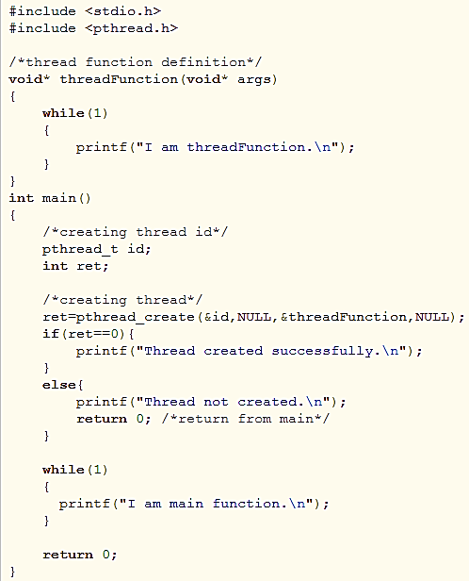
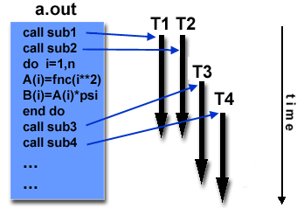
Threads Model
In the threads model of parallel programming, a single process can have multiple, concurrent execution paths.
Threads are commonly associated with shared memory architectures and operating systems.

Slide 41
Threads Model
Perhaps the most simple analogy that can be used to describe threads is the concept of a single program that includes a number of subroutines:
The main program a.out is scheduled to run by the native operating system. a.out loads and acquires all of the necessary system and user resources to run.
a.out performs some serial work, and then creates a number of tasks (threads) that can be scheduled and run by the operating system concurrently.
Each thread has local data, but also, shares the entire resources of a.out. This saves the overhead associated with replicating a program's resources for each thread. Each thread also benefits from a global memory view because it shares the memory space of a.out.
A thread's work may best be described as a subroutine within the main program. Any thread can execute any subroutine at the same time as other threads.
Threads communicate with each other through global memory (updating address locations). This requires synchronization constructs to insure that more than one thread is not updating the same global address at any time.
Threads can come and go, but a.out remains present to provide the necessary shared resources until the application has completed.

Slide 42
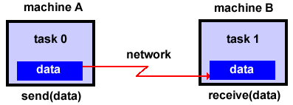
Message Passing Model
The message passing model demonstrates the following characteristics:
A set of tasks that use their own local memory during computation. Multiple tasks can reside on the same physical machine as well across an arbitrary number of machines.
Tasks exchange data through communications by sending and receiving messages.
Data transfer usually requires cooperative operations to be performed by each process. For example, a send operation must have a matching receive operation.

Slide 43
Topics discussion (in-depth with scenarios)
What is parallel computing?
Concurrency vs Parallelism
Parallel data and Parallel data structures
Task and Data Parallelism (both in Shared memory and Distributed Memory)
NADRA Scenario for data parallelism
Task parallelism scenario
Distributed System: Single PC to Clusters to Data Center
Individual PC → Racks → Cluster → Data centers
How to compute total cores, storage and network capacity of a data center?
Which problem is a parallel problem?
Communication and Computations in terms of Granularity
Multitasking and Multiprogramming
Parallel System resources
UMA, NUMA, and Cache Coherency
What to consider before writing a parallel algorithm?
Steps to be following to convert a serial program into a parallel one.

